Slide 1
Restful Web Services
- By Priyanka Singhal

Slide 2
Content

Slide 3
What are Web Services?
Web services are open standard (XML, SOAP, HTTP etc.) based web applications that interact with other web applications for the purpose of exchanging data.
A web service is any piece of software that makes itself available over the internet and uses a standardized XML messaging system.
As all communications are in XML so web services are not tied to any one operating system or programming language.
Web services are self contained, self describing, modular, distributed and dynamic applications.

Slide 4
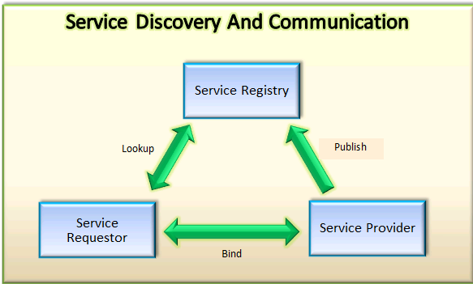
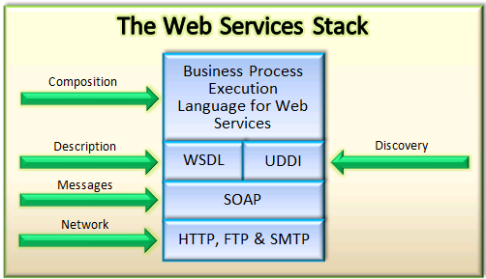
Web Service Architecture
There are two ways to view the web service architecture -
By the role of each web service actor
By the web service protocol stack

Slide 5
RESTful Web Services - Introduction
RESTful Web Services are REST architecture based web services.
REST stands for REpresentational State Transfer. It is web standards based architecture which uses HTTP Protocol for communication.
In REST architecture, a REST Server simply provides access to resources and REST client accesses the resources.
Each resource is identified by URIs or global IDs.
REST uses various representations to represent a resource like text, JSON and XML.
GET, PUT, DELETE, POST, OPTIONS well known HTTP methods are commonly used in REST based architecture.

Slide 6
RESTful Web Services - Resources
REST architecture treats every content as a resource which is similar to an Object in Object Oriented Programming or similar to an Entity in Database.
Once a resource is identified then its representation is to be decided using a standard format. For ex. - User is a resource which is represented using the below XML format-
<user>
<id>1</id>
<name>Priyanka Singhal</name>
<profession>Software Engineer</profession>
</user>
Following are some important points to be considered while designing a representation format of a resource in RESTful web services –
1. Understandability
2. Completeness
3. Linkability

Slide 7
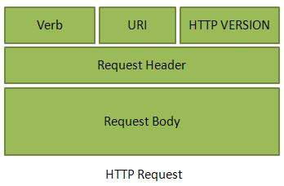
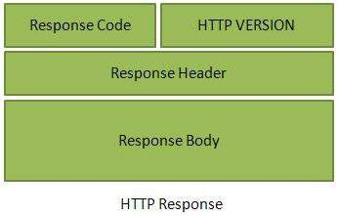
RESTful Web Services - Messages
RESTful web services make use of HTTP protocol as a medium of communication between client and server. A client sends a message in form of a HTTP Request and server responds in form of a HTTP Response. This technique is termed as Messaging.

Slide 8
RESTful Web Services - Addressing
Addressing refers to locating a resource or multiple resources lying on the server. Each resource in REST architecture is identified by its URI, Uniform Resource Identifier.
A URI is of following format:
<protocol>://<service-name>/<ResourceType>/<ResourceID>
Following are important points to be considered while designing a URI:
1. Avoid using spaces
2. Use lowercase letters
3. Maintain Backward Compatibility
4. Use Plural Noun
5. Use HTTP Verb

Slide 9
RESTful Web Services - Stateless
By stateless it means that the web server does not store any state about the client application or session. As per REST architecture, a RESTful web service should not keep a client state on server.
The relevant session information is stored on the client and passed to the server as needed.
That is where the ST in REST comes from, State Transfer. You transfer the state around instead of having the server store it. This is a way to scale to millions of concurrent users.
Web services need not to maintain client's previous interactions. It simplifies application design.
As HTTP is itself a statelessness protocol, RESTful Web services work seamlessly with HTTP protocol.

Slide 10
RESTful Web Services - Caching
Caching refers to storing server response in client itself so that a client needs not to make server request for same resource again and again.
A server response should have information about how caching is to be done so that a client caches response for a period of time or never caches the server response.
Following are the headers which a server response can contain to configure a client's caching:
1. Date - Date and Time of the resource when it was created.
2. Last Modified - Date and Time of the resource when it was last modified.
3. Cache-Control - Primary header to control caching. Ex. – Public, Private, No-cache etc.
4. Expires - Expiration date and time of caching.
5. Age - Duration in seconds from when resource was fetched from the server.

Slide 11
RESTful Web Services - Security
As RESTful web services work with HTTP URLs so it is very important to safeguard a RESTful web service in the same manner as a website is be secured.
Following are the best practices to be followed while designing a RESTful web service-
1. Validate all inputs on the server.
2. Use session based authentication to authenticate a user whenever a request is made.
3. Never use sensitive data i.e. username, password or session token in URL.
4. Allow restricted use of methods like GET, POST, DELETE. GET method should not be able to delete data.
5. A web service method should use HTTP error messages. For ex. – 201 for Created, 204 for No Content, 304 for Not Modified, 403 for Access Forbidden etc.

Slide 12
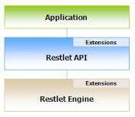
Restlet - Introduction
Restlet is a lightweight, comprehensive, open source RESTful web API framework.
Restlet is suitable for both server and client Web applications.
It supports major Internet transport, data format, and service description standards like HTTP and HTTPS, SMTP, XML, JSON etc.
The Restlet framework is composed of two main parts-
Restlet API supporting the concepts of REST and facilitating the
handling of calls for both client-side and server-side applications.
Restlet API is backed by the Restlet Engine and both are now
shipped in a single JAR ("org.restlet.jar").

Slide 13
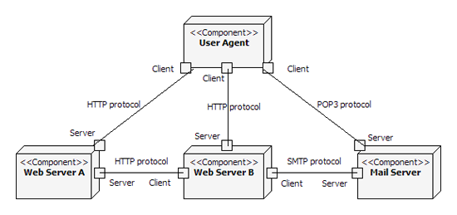
Restlet - Architecture
In the diagram below-
Ports represent the connector that enables the communication between components.
The links represents the particular protocol (HTTP, SMTP, etc.) used for the actual communication.

Slide 14
Example -
public static void main(String[] args) throws Exception {
// Create a new Restlet component and add a HTTP server connector to it
Component component = new Component();
component.getServers().add(Protocol.HTTP, 8080);
// Then attach it to the local host
component.getDefaultHost().attach("/uri_pattern", TargetRestlet.class);
// start the component!
component.start();
}

Slide 15
Contd.
A component is an abstract unit of software instructions and internal state that provides transformation of data.
It allows easy configuration of the list of supported client and server connectors as well as services.
We can add and configure virtual hosts (including the default one).
We can configure the server context parameters i.e. maxThreads, maxTotalConnections, maxConnectionsPerHost etc. Here context is the means by which a Restlet may access the software environment within the framework.
We can also attach applications either using their fully qualified class name or by pointing to a descriptor document (at this time only WADL description are supported).
In RAIM Service, We have created an instance of JaxRsApplication class which is used for the instantiation of a JAX-RS runtime environment.

Slide 16
Contd.
We have created a sub application which will be added

